Slide 1


HOME
ABOUT
CONTENT
OTHERS
Electric-Vehicles (EV) data analysis
Prepared by:
.
Mohamed Khaled
Hazem Ehab
Omar Abdelatif

Slide 2
HOME
ABOUT
CONTENT
OTHERS
Introduction

Slide 3
HOME
ABOUT
CONTENT
OTHERS
Mind map :
Brain storming.
Gathering most suitable data.
Store data base in SQL server.
Explore the data
Transform the data and add the measures.
Get the data from SQL into Power bi.
Add measures in power bi.
Then represent the data.

Slide 4

HOME
ABOUT
CONTENT
OTHERS
Data gathering
Source : (Data.gov).
. Dataset : Electric Vehicle Population Data.

Slide 5
HOME
ABOUT
CONTENT
OTHERS
SQL server

Slide 6
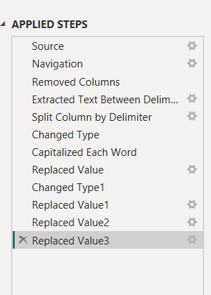
HOME
ABOUT
CONTENT
OTHERS
SQL server
Data Cleaning Steps
Fixed Locations: Split coordinates into Latitude and Longitude for the map.
Cleaned Text: Fixed capitalization for Make and Model names.
Handled Nulls: Replaced empty cells with "Unknown" for better visuals.
Removed Junk: Deleted unnecessary columns to make the file faster.
Fixed Types: Ensured all columns (Dates, Numbers, Text) have the correct format.

Slide 7

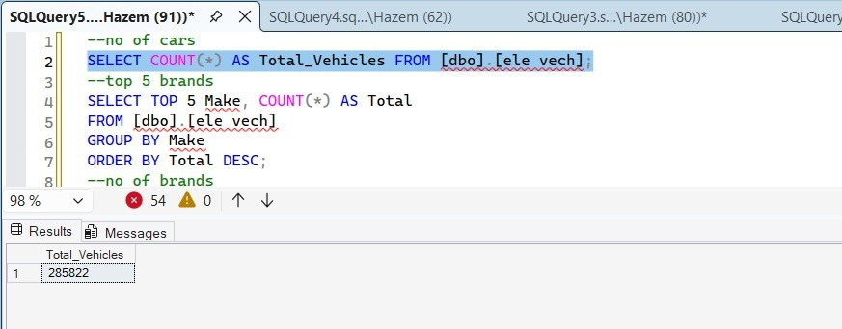
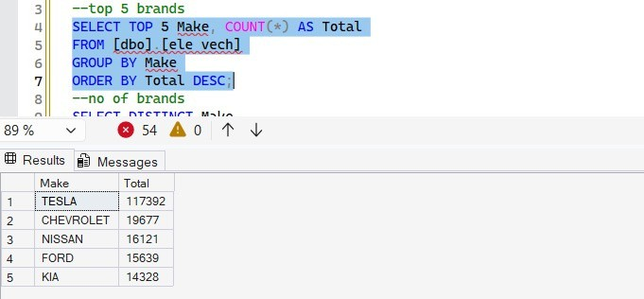

HOME
ABOUT
CONTENT
OTHERS
SQL server
"Used COUNT(*) to calculate the total volume of data."
"Used GROUP BY and ORDER BY
DESC to rank the leading manufacturers."

Slide 8

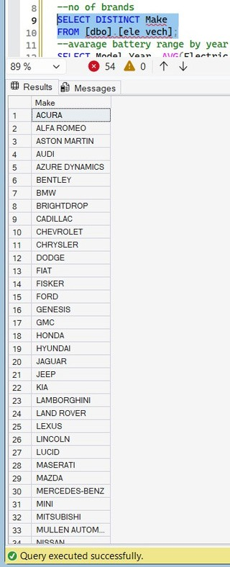
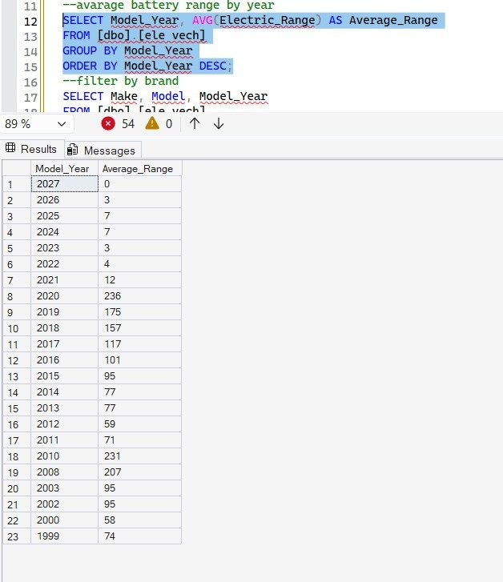

HOME
ABOUT
CONTENT
OTHERS
"Used DISTINCT to remove duplicates and list all unique brands."
"Used AVG and GROUP BY to track the technical progress per year."
NEXT SLIDE

Slide 9

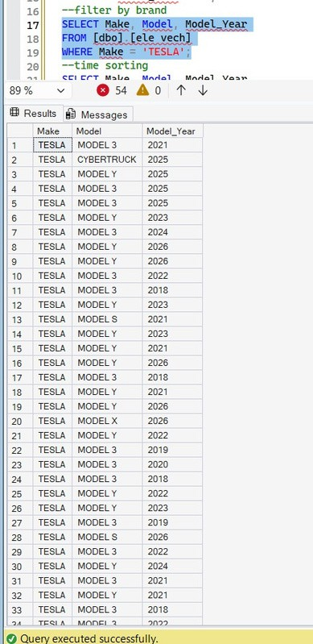

HOME
ABOUT
CONTENT
OTHERS
"Used ORDER BY DESC to sort vehicles from newest to oldest."
NEXT SLIDE
"Used WHERE to isolate Tesla records and analyze its specific models."

Slide 10


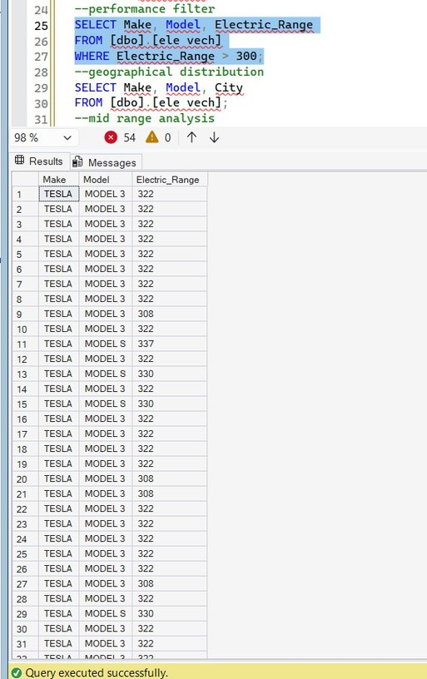
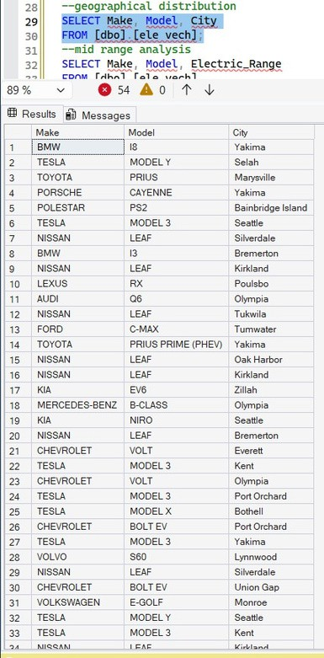
HOME
ABOUT
CONTENT
OTHERS
"Used WHERE with a numerical condition (> 300) to find high-range cars."
"Used SELECT for specific columns to map car locations by city."
NEXT SLIDE

Slide 11

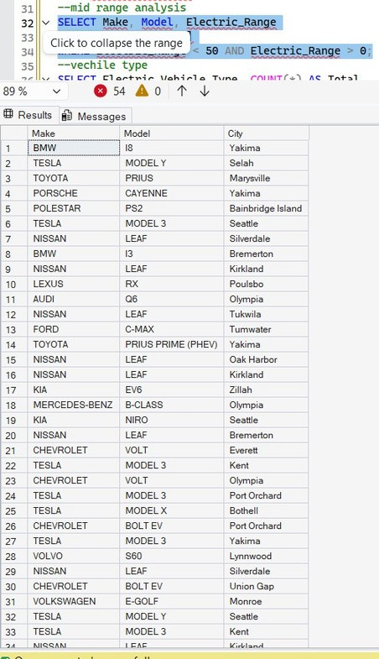
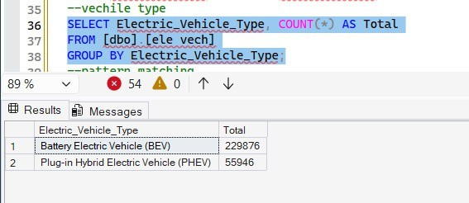

HOME
ABOUT
CONTENT
OTHERS
"Used GROUP BY to compare the totals of BEV vs. PHEV types."
"Used WHERE with AND to filter cars
within a specific range (0-50 miles)."
NEXT SLIDE

Slide 12

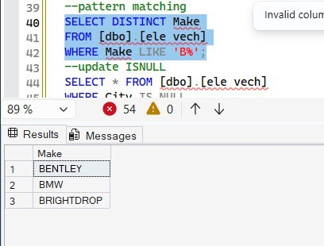
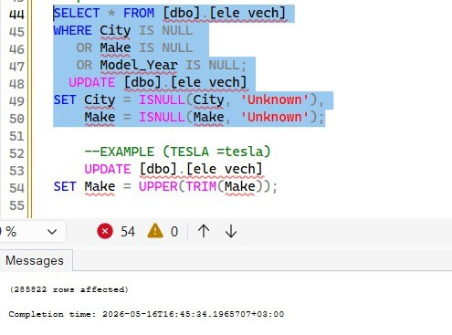

HOME
ABOUT
CONTENT
OTHERS
"Used LIKE with % to find brands "Used WHERE ... IS NULL to detect any
missing data in the table and Used UPDATE and ISNULL to fill empty cells with 'Unknown'."
starting with a specific letter."
NEXT SLIDE

Slide 13
HOME
ABOUT
CONTENT
OTHERS
Power BI

Slide 14
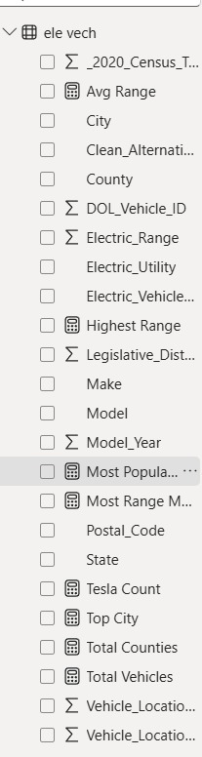
HOME
ABOUT
CONTENT
OTHERS
Power BI
Building Measures (DAX):
Smart Math: Created formulas to calculate data automatically.
Key Results: Calculated Total Cars, Average Range, and Top Cities.
Deep Insights: Found the Best Models and Market Leaders.
Fast & Live: All numbers update instantly when you click any filter.

Slide 15

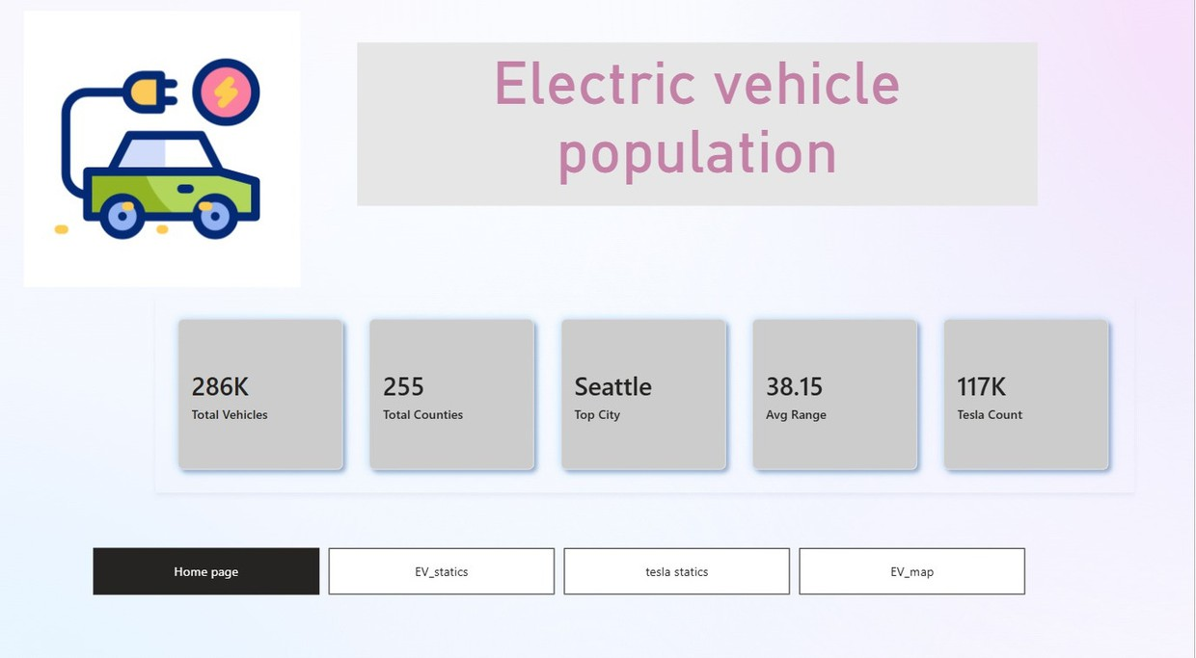
HOME
ABOUT
CONTENT
OTHERS
Home page

Slide 16
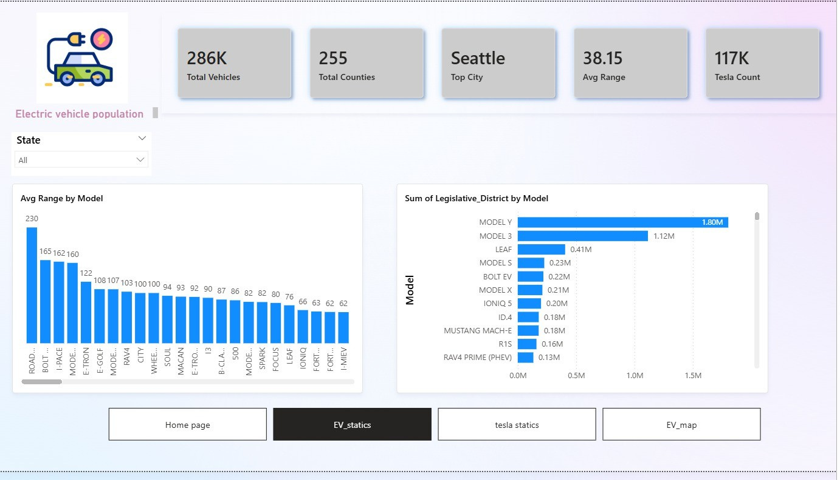
EV page

Slide 17
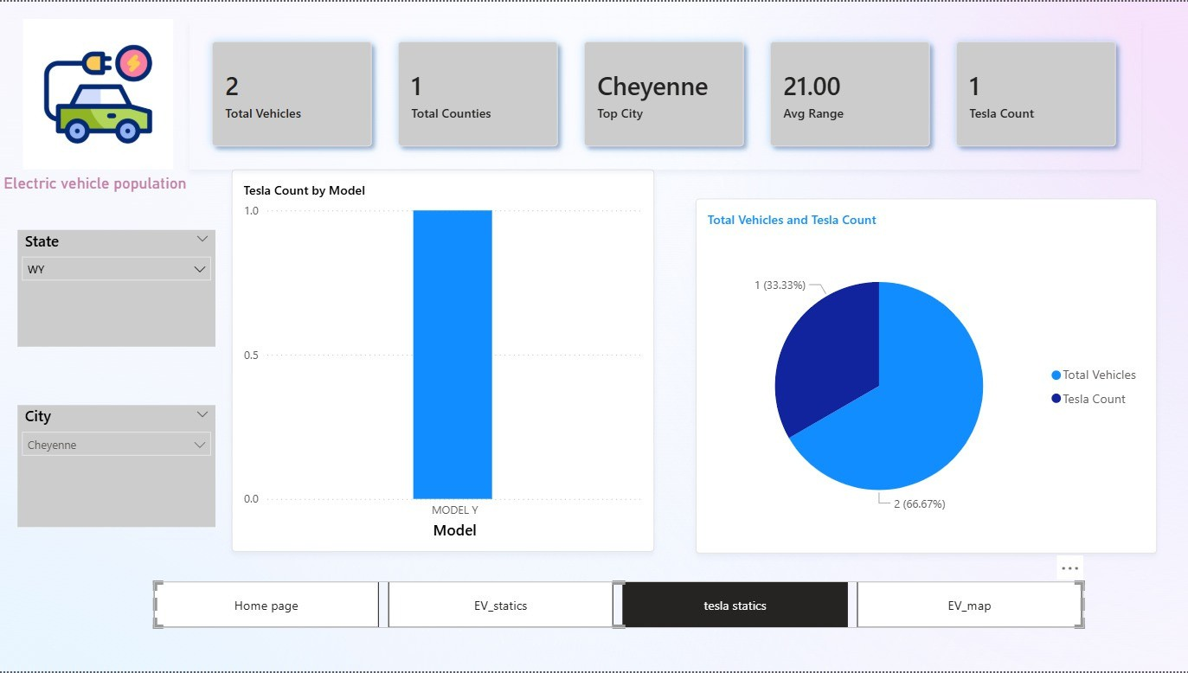
Tesla page

Slide 18
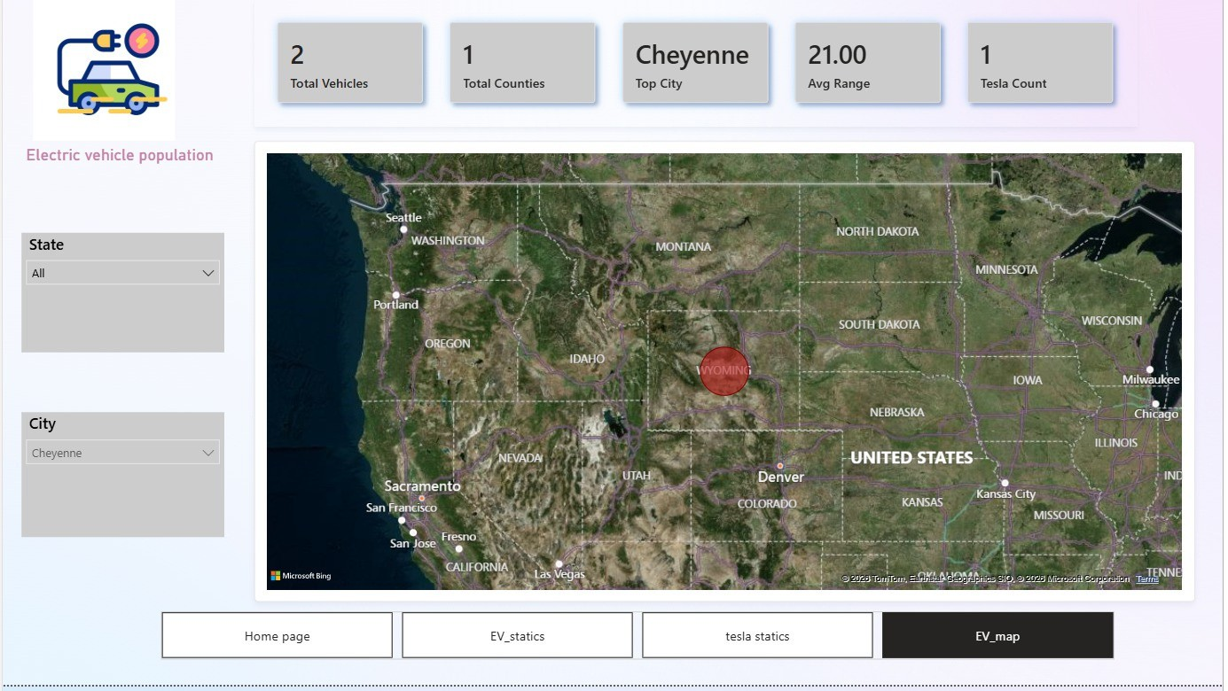
Distribution page

Slide 19


HOME
ABOUT
CONTENT
OTHERS
THANK
YOU

